Slide 1
WELCOME TO
A History of Cannabis
By
Alexandra Verello

Slide 2
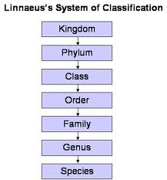
Taxonomy
The Science of Classification created by Carolus Linnaeus (Britannica)
Cannabis Taxonomy
Kingdom
Plantae
Phylum (Division)
Tracheophyta – vascular plants
Class
Magnoliopsida
Order
Rosales
Family
Cannabaceae
Genus
Cannabis
Species
Sativa
”L” Refers to authority
meaning the person who
discovered/named the organism
Cannabis sativa L.
Binomial
Nomenclature
(Herer)

Slide 3
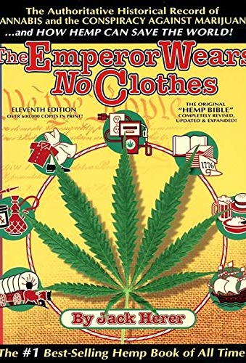
History of Cannabis
Earliest mention was by Dioscorides (40-90 AD). Published first source of modern botanical terminology/ ethnobotanical literature De Materia Medica.
Cannabis is referenced in this book as useful for fiber/ rope and roots of the plant were said to be used to relieve joint pain after being boiled.
Terms “Sativa” and “Indica” were introduced by Jean Baptiste Lamarck, a naturalist, Botanist and Zoologist (1785) (Watts 2006)
Cannabis made its way westward via the slave trade.
As cannabis entered the United States from Mexico in mid 1960’s, whole plants were dried, shipped and sold to users.
The potency of this substance was remarkably low compared to today’s market.

Slide 4
History Continued
In 1619 the first American Cannabis Law was enacted in Jamestown colony.
REQUIRED all farmers to run a trial of Indian hemp seed.
Cannabis hemp was legal tender (money, basically) in most of America until ~1800s.
You could even pay taxes with it!
It was possible to be jailed for NOT growing Hemp especially during shortages.
Thomas Jefferson even illegally imported hemp seed from China to Turkey, he eventually used the variety he smuggled to start America’s first paper mill.
Cannabis derived extracts were also among the top prescribed medications from ~1842-1890.

Slide 5
As the war on drugs came into effect under Nixon, cannabis growers and retailers had to rethink the ergonomics of their practices to keep their actions under the radar and their black-market customers satisfied.
At this point, growers begin experimenting with methods to create a plant that will:
Grow more quickly
Maintain smaller stature
Pack more potency per weight

Slide 6
Hemp vs. Marijuana
Legally classifying a Cannabis plant as either Hemp or ‘Marijuana’ depends entirely on its THC content.
Plants grown as Hemp must have under a certain amount of THC, this mount varies by state.
If compliant with 2018 Farm Bill (like NJ is), total THC cannot exceed >0.3%.
For more on this, visit: https://www.nj.gov/agriculture/divisions/pi/prog/nj_hemp.html
‘Marijuana’ is a term that originated ~ 1920’s and was utilized heavily by Richard Nixon to describe the Cannabis that was coming up from Mexico to make it sound foreign, and negative.
Today, ’Marijuana’ is used to refer to any Cannabis with a THC content over 0.3%
**Industry professionals of today are not so fond of the word ‘marijuana.’ #HerNameIsCannabis
(USDA)(HERER)

